Slide 1
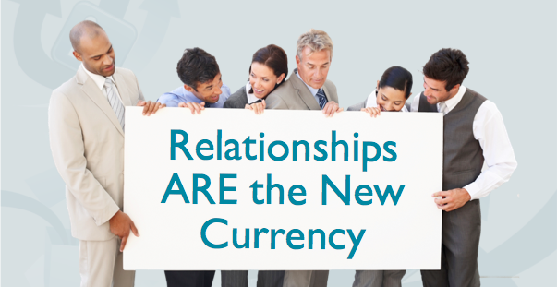

Slide 2
Change Your Framework—Change Your Future

Slide 3
Welcome to the Age of Influence…
where anyone can build an audience and effect change, advocate brands, build relationships, and make a difference.

Slide 4
Fans, Friends, Followers Audience? Or Asset?

Slide 5
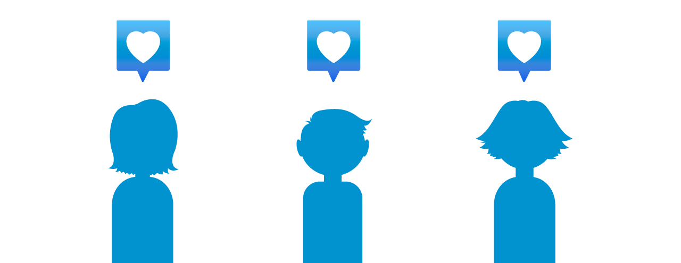
One by One…

Slide 6
Social is a facilitator of relationships, it is not the relationship itself!

Slide 7
A “Brand” is what a business does, and a “Reputation” is what people remember and share.

Slide 8
Think REPUTATION, not ranking…
CONNECTION, not network…
LOYALTY, not celebrity.

Slide 9
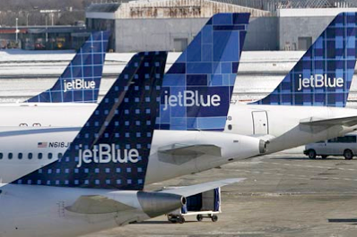
Return on Relationship
JetBlue Gets It!

Slide 10
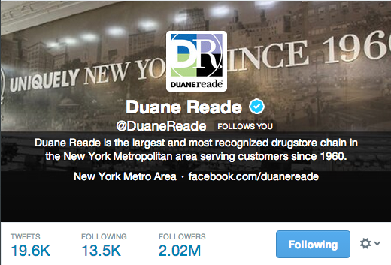
Return on Relationship
Duane Reade Lives It!
Notes:
Most followed drug store/retailer on Twitter. Engaging content, VIP program… Omni Channel approach utilizing Parallel Persuasion

Slide 11
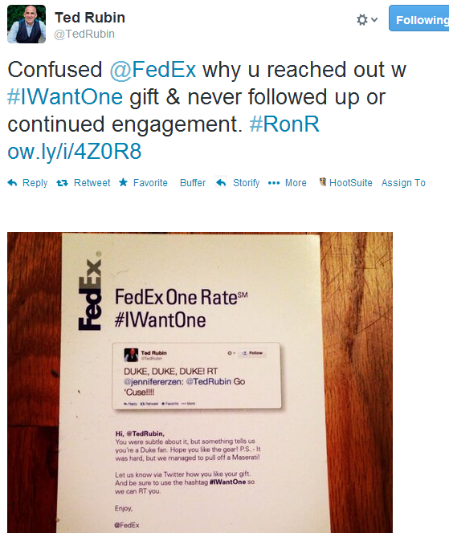
FedEx…No So Much!

Slide 13
Most consumers are inviting you into their living room…
Notes:
and you are not even bothering to go there ???

Slide 14
Don’t Ignore the Listeners
Embrace social Lurkers... or you will most certainly be sweeping diamonds out with the dust!

Slide 15
In today’s market, REAL trumps PERFECT because real is what creates…
Notes:
Participate
Experiment
Engage and build relationships with key advocates (and detractors)
Measure things that matter
Have some fun!

Slide 16
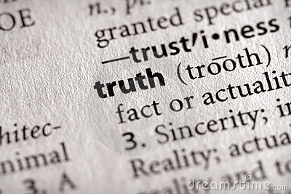
Brand are from Mars, Consumers are from Venus... Brands need to change the way they communicate!
Notes:
More Facilitation… Less Fabrication

Slide 17
Listen
Make it be about THEM
Ask “How can I serve you?”
Aim for Ongoing Engagement
Look People in the Eye Digitally

Slide 18
Listen for “Moments”
and Make it Personal
Notes:
Boys and Colors
On the beach in Ixtapa

Slide 19
Notes:
If we let fear get in the way, we trade innovation for stagnation… genius for mediocrity … adventure for boredom. Which sounds better to you?
Fear of change and Fear of hard work.
We are a lock-and-load society.

Slide 20
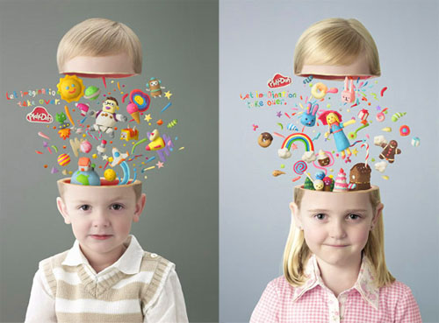
Think like a child... and change your creative mindset to one that works!
Notes:
Children playing with blocks
Digging to China

Slide 21
When someone asks me… what is the ROI of Social?
I ask… what is the ROI of Trust and what is the ROI of Loyalty?
Notes:
Creating Trust leads to Loyalty and…
Customers spend more money, and you’ll be more profitable.
This is not rocket science folks!

Slide 22
Being Social drives Engagement, Engagement drives Loyalty and Advocacy, and both correlate directly to Increased Sales.
ROR (#RonR) = ROI
Notes:
Awareness = Revenues
Differentiators = Margins
Authenticity = Loyalty/Advocacy
All Measurable AND = Increased Sales/Profits.

Slide 23
Engage/Captivate... and make Remarkable
Notes:
Likely to be noticed especially as being uncommon or extraordinary
A brand will become critically valuable to consumers & employees if they invest their own time & resources in it.

Slide 24
Amplify Customer Experience
Make it better by ”really” listening to them
Put customer convenience first
Be useful, Be interesting… stay clear of one-size-fits all
Empower people to share. (People love sharing!)
Focus on unmet needs, and be one step ahead
Add value in every customer interaction
Notes:
iPhone – PICK UP THE PHONE

Slide 25
You know what doesn’t work for a social media strategy?
NOT BEING SOCIAL.
Notes:
Leave you with one more thought - Skipping

Slide 26
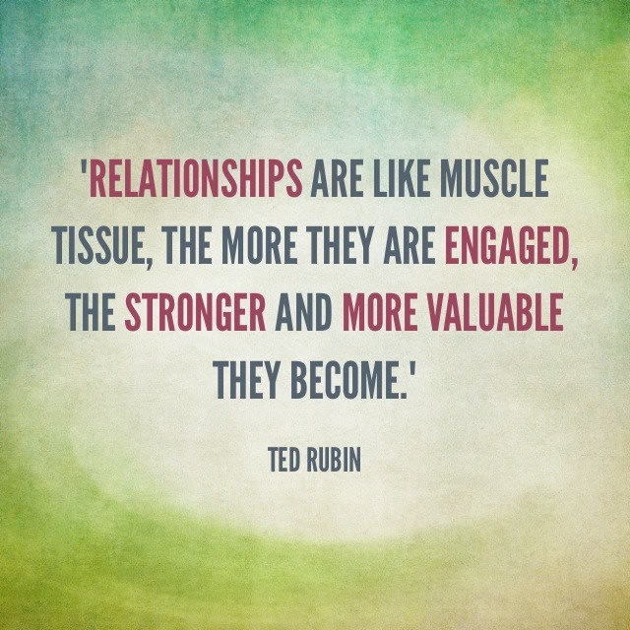
Return on Relationship back cover quote…
“In the connection economy, trust and relationships are the new currency. It's not a soft thing you do in your spare time, it's the heart and soul of your business.”
~Seth Godin, Author of Tribes
@TedRubin
TedRubin.com
ReturnOnRelationship.com
tedrubin@gmail.com

