Slide 1
Customer Experience with Return on Relationship
Ted Rubin
The Rubin Organization
Strategic Relationship Consultant, Evergreen Trading
Notes:
If you want to build your brand… Own the Customer Experience.
Because the way I see it… Customer Experience is your only true “REAL” branding

Slide 2
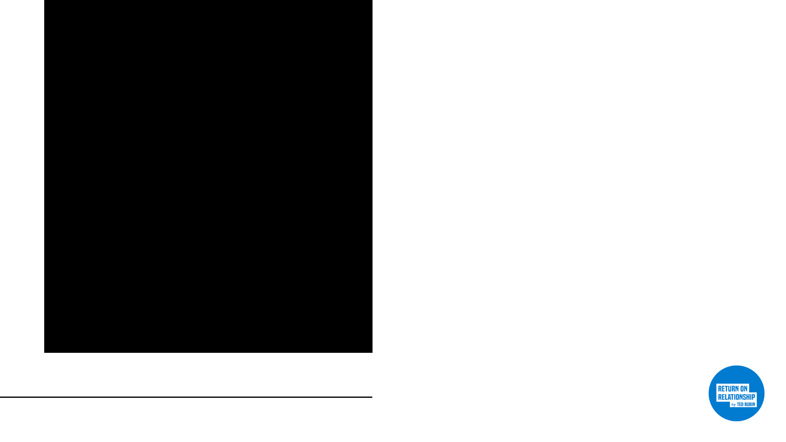
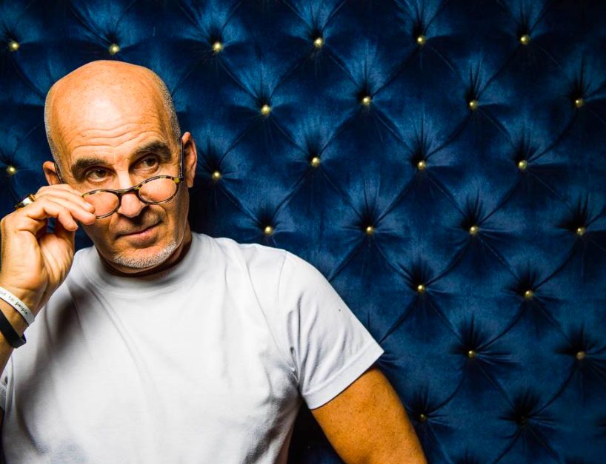
Open your minds right now that there might be another way,
and allow me to take you down that path.
Notes:
Companies Need to Step Beyond Simply Creating a “Culture” and Nurture “Employee Community.”

Slide 3

Winning in service markets, winning in every market…
is all about customer experience!
Notes:
Marketing/Communications/Customer Serivce are all interconnected,
and in order to deliver an OmniPresent experience externally…
you must create an OmniPresentl culture internally!

Slide 4
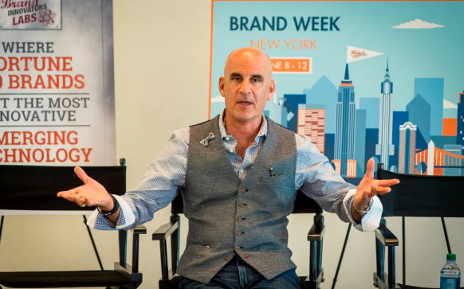
When everyone has a stake in the outcome, the customer isn’t the only winner —
everyone benefits
Notes:
We need to look at what we do from a ”what’s next” perspective.

Slide 5
Your goal with every outreach, interaction, and inbound customer engagement should be to…
Gain Social Trust.
Notes:
Social is a Shared Trust… Keep the trust, keep the permission, keep the customers
WHEN PEOPLE ASK ME, what’s the ROI of Social…

Slide 6
Always remember that the only time
you have 100% of your customer’s attention is when they are looking
for Customer Service…
DO NOT MISS THAT OPPORTUNITY!
Notes:
This is the very best time to MARKET to your CUSTOMER, and Make them ADVOCATES…
“use DAUGHTERS with hand out for $’s example”

Slide 7
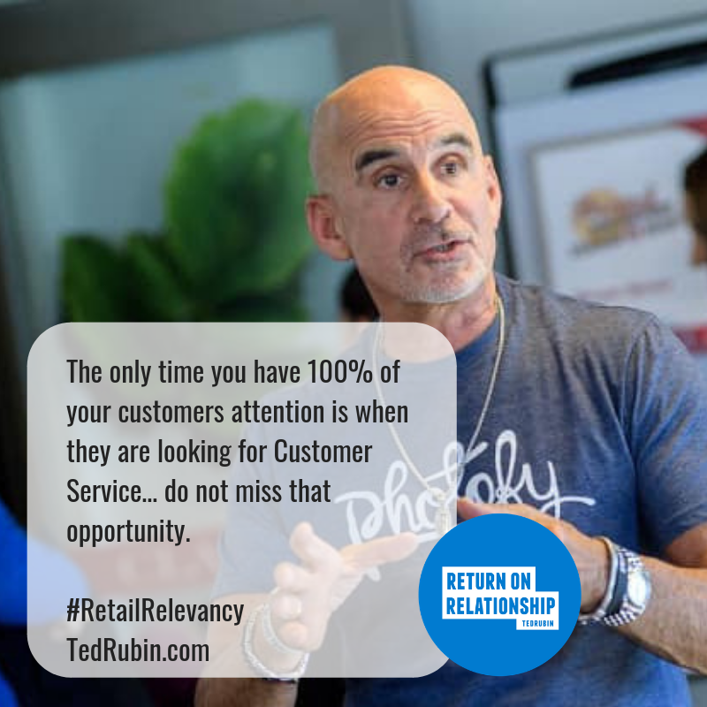
Notes:
YOU NEED TO SEE THIS A SECOND TIME!
AND it’s time to understand that Customer Service goes well beyond what what is specifically categorized as Customer Service
Change the mindset from Cusutomer Service to… SERVICING CUSTOMERS

Slide 8
A “Brand” is what a business does
and a “Reputation” is what people remember and share.
Notes:
Let’s think about this a bit.
Self-awareness, Empathy, Sincerity
Everyone and Every Company makes mistakes… it’s what you do next that matters!

Slide 9
Think REPUTATION, not ranking...
CONNECTION, not network
LOYALTY, not celebrity
Notes:
Connection means you know someone, Network often means a distant link…
A Network gives you Reach, a Community gives you Power.
Networks Connect, Communities Care!

Slide 10

If you are only focused on the Money
You risk completely overlooking the People
Notes:
Establishing Trust…
A Crucial Pillar in Building Customer Experience

Slide 11
It’s time to forget the buzzword
OmniChannel, which is still a siloed concept, and start thinking…
OmniPresent
Notes:
You may have picked up my earlier mention of OmniPresent

Slide 12
An integrated OmniPresent experience connects your employees so they can collaboratively deliver a seamless experience.
Notes:
Communication is Key
We know that in order to build trust with another person,
there must be good two-way communication

Slide 13
An OmniPresent approach goes beyond connecting your various channels and assigning people to engage and connect
with customers…
Notes:
.Be where your customers are and be prepared to deliver and communicate in the way they prefer.
‘Girl’s story about communicating”
Connecting your employees so they can collaboratively deliver a seamless experience.

Slide 14
…it makes it super-easy,
AND empowers employees
to connect and bond with each other.
Notes:
Enable and empower connection so your employees can collaboratively deliver a seamless experience.
AND THE NEXT STEP IS…

Slide 15
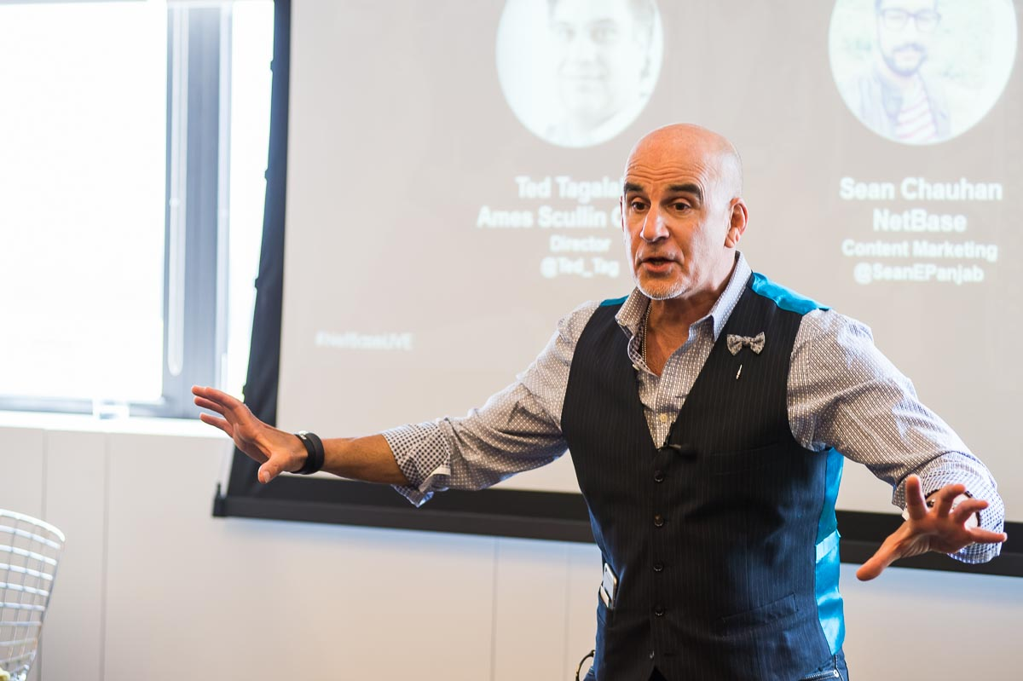
Set the stage for innovation by bringing back real brainstorming!
Notes:
Brainstorming too often becomes the narrow view of a few (very) vocal people

Slide 16

Where brains are actually storming…
True brainstorming = diversity of thought
Notes:
Start by listening and taking employees ideas seriously. Don’t dismiss new ideas out of hand, and don’t try to corral everyone in the brainstorming session into focusing on the same few ideas, from the same few people.

Slide 17
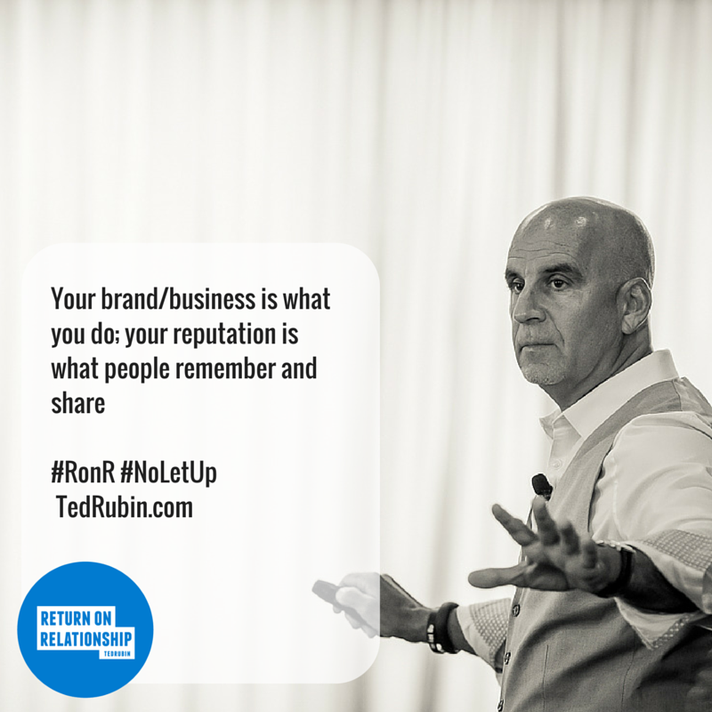
Notes:
SO IMPORTANT TO REMEMBER!
You may notice I repeat myself a lot… BECAUSE I’m trying to break through the noise.

Slide 18
The six words to never say if you want to remain competitive…
“We’ve always done it this way.”
Notes:
YES… THIS STILL HAPPENS, I HEAR IT! This is backwards thinking… need to start thinking forward.
Things are changing too quickly to get stuck in the past.

Slide 19
ABC (Always Be Changing)
Developing a system that ensures that everyone is on board, while breaking internal barriers, are key to delivering seamless customer experiences.
Notes:
Instead of Always Be Closing… Closing implies the Hunt, Targeting, and END.
Changing implies… Evolving and Adapting
Change your company marketing mindset from that of “Targeting” to “Matchmaking…

Slide 20
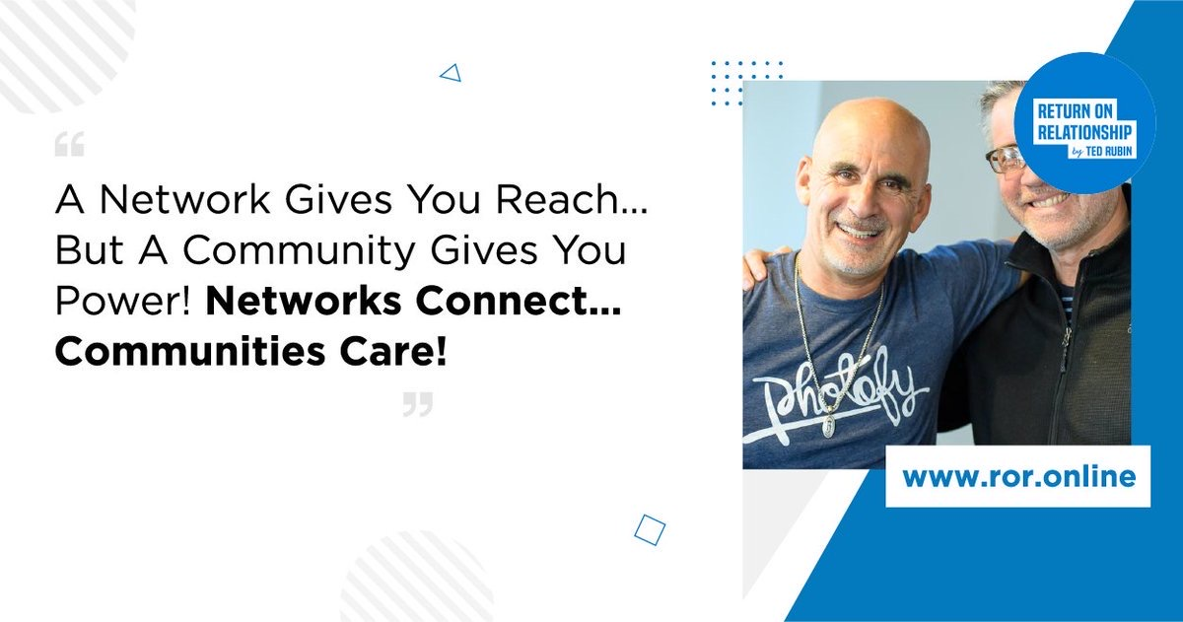
Notes:
No “Advocacy Program” needed if the company builds a culture of empowerment and community…
encompassing employees’ ability to think, brainstorm and share

Slide 21

Loyalty Marketing from Within...
Empower Your Employees and they will Power your brand
Notes:
Your Employees will create Loyalty for your Company when they are Empowered to…
THINK
CREATE
PROBLEM-SOLVE

Slide 22
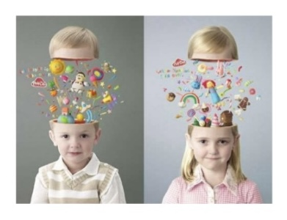
Encourage them to think like a child again...
and change their creative mindset to one that works!
Notes:
Attitude, Perspective… Mindset
WE NEED TO… (next slide)

Slide 23

Empower
Creativity
Notes:
Playing with Blocks… Digging to China

Slide 24
A brand will become critically valuable to employees if they invest their personal brand and resources in it.
Notes:
Indifference is Expensive, Hostility is Unaffordable, TRUST is Priceless!
CFO asks CEO… what happens if we invest in our people and they leave.
CEO… what happens if we don’t and they stay?

Slide 25
To Amplify Customer Experience
Make it better by ”really” listening to them
Always address them by name
Be useful, Be interesting… stay clear of one-size-fits all
People love to share… make it easy
Engage/Captivate... and make Remarkable
EMPOWER YOUR EMPLOYEES to do these things…
and THEY will POWER your Brand.
Notes:
LET’S BRING THIS ALL TOGETHER…
You do all of this, and make it part of your culture and you will generate…
RETURN ON RELATIONSHIP with your Customers AND your Employees

Slide 26
Awareness = Revenues
Differentiators = Margins
Authenticity = Loyalty/Advocacy
All Measurable AND = Increased Sales/Profits.
Notes:
Companies that embrace Customer Service (Servicing Customers) as a MINDSET, instead of as a Department…
WILL WIN!

Slide 27

Relationships
ARE
currency!
Honor them…
Invest in them!
Notes:
Because now everyone is interconnected, everyone has influence over someone…
and we can scale relationships anytime, anywhere.
RETURN ON RELATIONSHIP can be your differentiator in this commodity driven world.

Slide 28
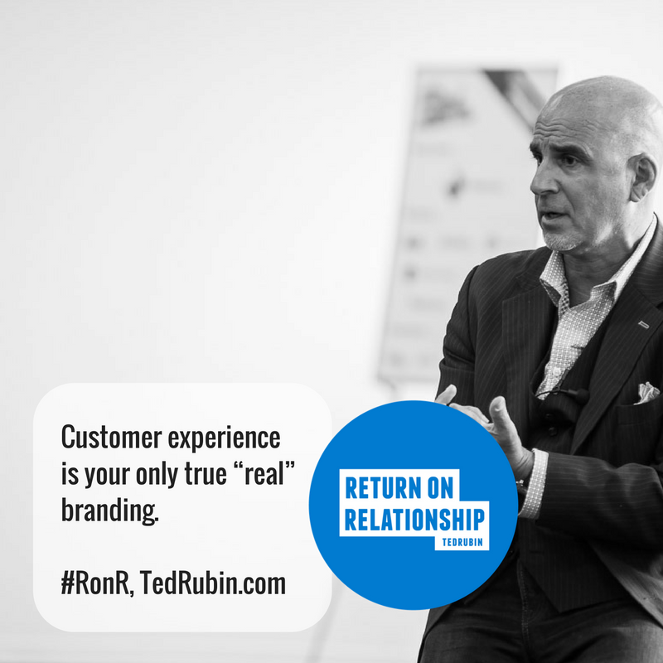
Notes:
I opened with this… and I am going to close with it!
AND Customer Service is the ONLY TIME YOU HAVE 100% of the attention of your customers… do not waste that opportunity.
SO…

Slide 29
SO… Customer Experience, Empowering Employees, and Return on Relationship come down to…
#BeGoodToPeople
Notes:
Because… Relationships are like muscle tissue,
the more you engage them the stronger and more valuable they become.
I would like to leave you with one last story… (SKIPPING)

